Slide 1

Running SU²
Pointwise® and SU2 Joint Workshop
Stanford University
Monday, September 29th, 2014
Heather Kline & Andrew Wendorff
Department of Aeronautics & Astronautics
Stanford University

Slide 2
Outline
SU² environment variable
What do I need to run a simulation?
Test case definition
Interactive session
Questions?

Slide 3
SU² Environment Variables
Did you set your SU² environment variables during the installation procedure?
i.e., in .bashrc:
# Set the SU2 source code home directory
export SU2_HOME=/Users/tomtaylor/SU2
# Identify directory where SU2 executables and python scripts are stored
Export SU2_RUN=/Users/tomtaylor/SU2Py
# Add SU2_RUN to the $PATH
Export PATH=$PATH:$SU2_RUN

Slide 4
Running Simulations with SU²
What do I need to run simulations with SU²?
Configuration file (.cfg)
Mesh file (.su2 or .cgns)
This session will use:
inv_NACA0012.cfg
Mesh_NACA0012_inv.su2
These are found in
su2.stanford.edu > Training
github.com/su2code/TestCases/inv_NACA0012/

Slide 5
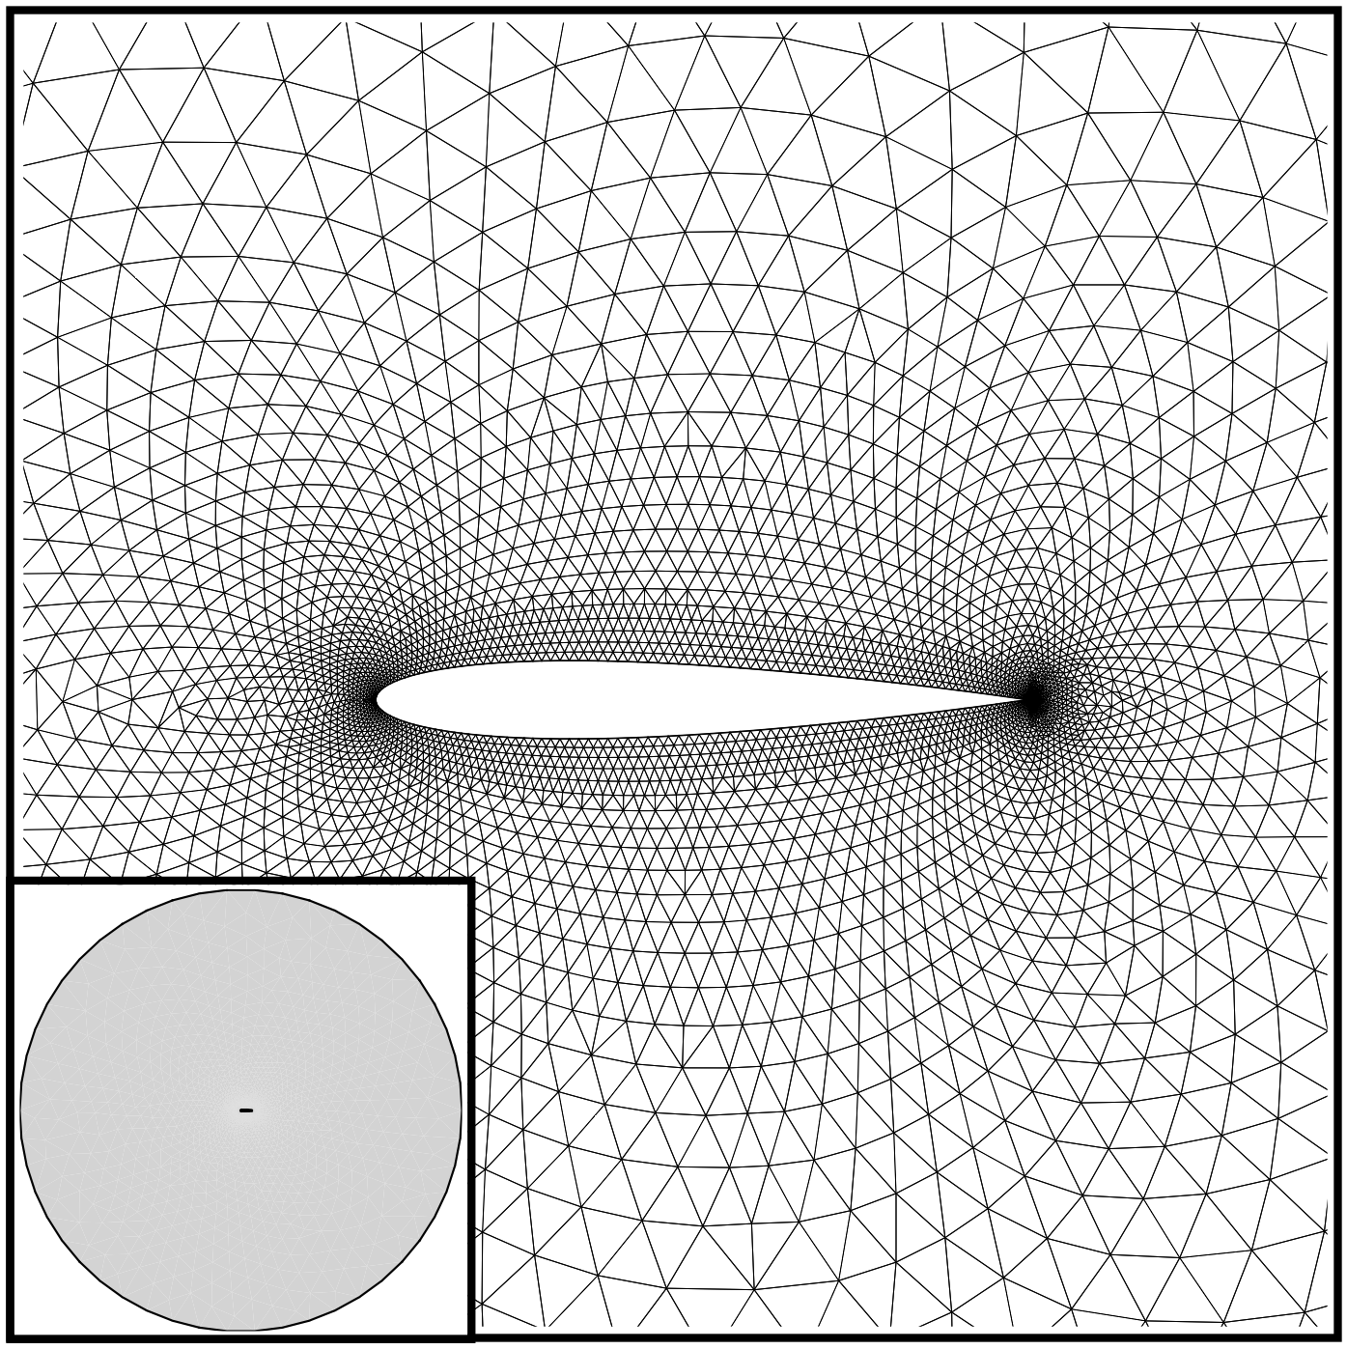
Test Case NACA 0012 Airfoil
Transonic, Euler flow
Mach No. = 0.8
Pressure = 101,325 Nm⁻²
Temperature = 273.15K
Angle of attack = 1.25º

Slide 6
Flow Solution
Config options:
Most parameters have default values
Order of config options is not important
PHYSICAL_PROBLEM= EULER
%
MATH_PROBLEM= DIRECT
%
MACH_NUMBER= 0.8
%
AoA= 1.25
%
FREESTREAM_PRESSURE= 101325.0
%
FREESTREAM_TEMPERATURE= 273.15
%
MESH_FILENAME= mesh_NACA0012_inv.su2

Slide 7
Restart
Simulations can be restarted from partially converged results
Config options:
RESTART_SOL= NO
%
EXT_ITER= 50
RESTART_SOL= YES
%
SOLUTION_FLOW_FILENAME= solution_flow.dat

Slide 8
Solver Parameters
Among the many options in the config file, various parameters exist to modify the solution method
Config options:
RESTART_SOL= NO
%
CFL_NUMBER= 4.0
%
CFL_RAMP= ( 1.1, 10, 10.0 )
%
CONV_NUM_METHOD_FLOW= ROE-2ND_ORDER

Slide 9
Interactive
Direct Solution

Slide 10
Adjoint Solution
Sensitivity of a functional to changes in the flow
e.g., How does changing the airfoil shape affect lift?
Additional required file:
Converged flow solution
Config options:
MATH_PROBLEM= ADJOINT
%
RESTART_SOL= NO
%
ADJOINT_TYPE= CONTINUOUS
%
ADJ_OBJFUNC= DRAG
%
SOLUTION_FLOW_FILENAME= solution_flow.dat

Slide 11
Interactive
Adjoint Solution

Slide 12

Example: Separated Flow Over Cylinder

Slide 13
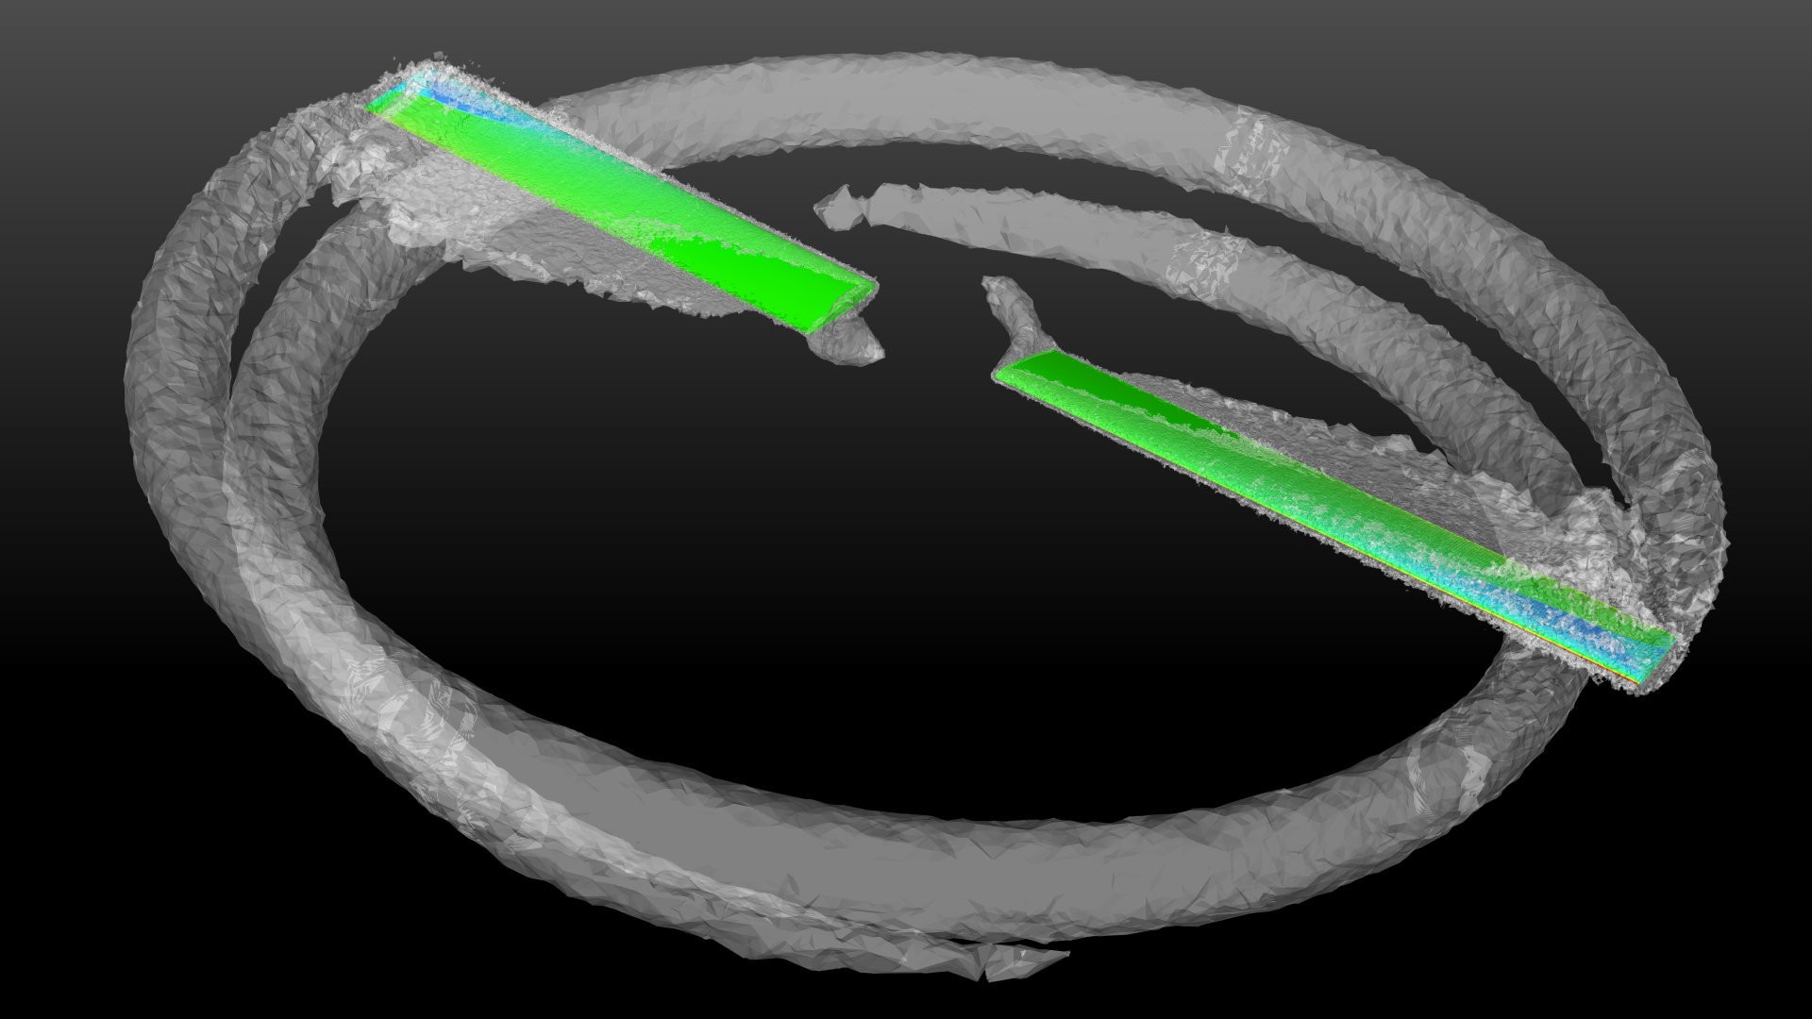
Example: Tip Vortices From Rotor

Slide 14
Additional Resources
Online documentation
http://su2.stanford.edu
Online tutorials
su2.stanford.edu > Training
also accessible via su2.stanford.edu > Guides > User’s Tutorials
TestCases directory
github.com/su2code/TestCases/
CFD Online forum
http://www.cfd-online.com/Forums/su2/

